Slide 1
Managing Chemicals in the Workplace:
Best Management Practices (BMPs)
with Emphasis on Chemical Storage
June 2016

Slide 2
Program Disclaimer
This program is meant to bring awareness to and orient the user in commonly employed best management practices for managing chemical storage in the workplace. The material contained in this PowerPoint presentation has been compiled from sources believed to be reliable and to represent the best information available on the subject at the time of and is representative of practices in place in industry, research organizations and academia in both the public and private sectors.
This program is not intended to be used as a complete chemical safety training program nor is it tailored to each possible user, institution or chemical storage situation (for example, outside chemical storage and storage of hazardous wastes are not addressed). Each institution or user of these program materials is encouraged to research information related to chemical storage requirements in their locality and the policies and procedures for same that are in place at their institution to decide if the program is adequate with respect to its facilities, operations, personnel, and work efforts. Each institution or individual that utilizes this program is still responsible for its own full compliance with all applicable federal, state or local laws, regulations, and rules related to safe operations and employee safety measures.
The use of this program falls under with the terms of use for materials posted on the CSHEMA web pages.

Slide 3
Importance of Safe Chemical Storage
Reduces the Risk of
Accident
Spill
Fire
Explosion

Slide 4
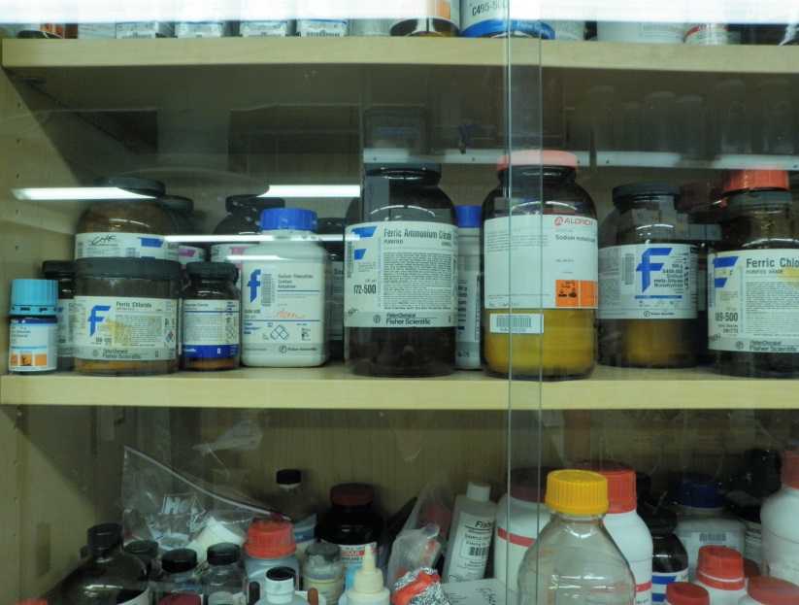
Course Objectives Include Discussion of the Following:
Compressed Gases
Cryogenic Liquids
Additional Considerations
Marking of Storage Areas
BMPs for transporting chemicals within the work place
Emergency Preparedness
Inspections
Security
Chemical Procurement Considerations
Receiving Guidelines
Chemical Inventory Management
Chemical Storage
Quantity Limitations
Segregation of Incompatibles
What about Multi-Hazard Chemicals?
General Storage BMPs, including
Container Management
Storage Areas
Housekeeping
Chemical Storage Cabinets
Refrigerated Storage
Desiccators
Hazard Class Specific BMPs
Corrosives (acids and bases)
Flammables
Toxins
Oxidizers
Highly Reactives (pyrophorics/water reactives, explosives, peroxide formers)

Slide 5
Best Practices when Ordering Chemicals
Check chemical inventory before ordering to
verify chemical is not already available and
ensure the amount of material you are ordering will not cause an exceedance of the allowed storage quantity limit
Before ordering determine if special handling precautions will be required and ensure
storage capacity for safely storing the quantity ordered is available,
the work area is equipped with the proper engineering controls and safety equipment required to work with the chemical and
that the proper PPE is available to users
Follow your institution’s requirements for obtaining preapproval for certain chemicals/chemical classes (ex. particularly hazardous substances or highly reactive materials, such as pyrophorics or explosives)
Order only what is needed to do the work currently planned or for regularly stocked materials what will be needed for a six month period
If you only need a very small amount of the material, determine whether you can obtain from another lab

Slide 6
Best Practices for Receiving Chemicals
Personnel with the potential of receiving, or otherwise processing, incoming chemicals must receive training on hazard recognition, safety precautions, security and incident response.
In addition, best management practices include, but are not limited to, the following:
Inspect packages upon receipt. Do not accept leaking packages
Packages must be stored by hazard class until delivered or collected by the end user
Transporting chemicals from receiving to storage or use locations must follow best management practices*
Don PPE appropriate for working with the chemical before opening packages
Follow your institution's protocols regarding opening packages. Some materials, such as highly toxic or volatile chemicals should be opened in well-ventilated spaces, such as a hood
NEVER ACCEPT FREE CHEMICALS!
Most institutions have strict policies about these types of ‘gifts’, including policies that discuss transfer of hazardous materials that include the requirement for a Materials Transfer Agreement (MTA) signed by upper management for such donations
Internal transfer from one PI to another must follow your institution’s chemical inventory management procedures
* Slides discussing some key safety tips for transporting chemicals within the workplace are included later in this presentation, but do not cover all possible scenarios

Slide 7
Chemical Inventory Management
Upon Receipt of Chemical
Managing Inventory
Unpack and date container with receipt date and any other internal label, such as peroxide former, required by your institution’s procedures
Add chemical to your inventory system
Place chemical in its designated storage location
File Safety Data Sheet (SDS) and other technical data received with chemical per your institution's policies
A current inventory is important to ensure quantity limits for chemical storage are not exceeded
Regularly review chemicals in inventory to
Ensure use of older chemicals first
Deplete existing stock before ordering more
Identify unwanted or off spec (expired) chemicals for disposal

Slide 8
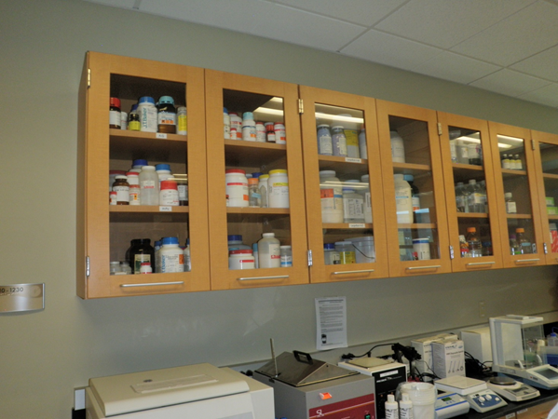
Chemical Storage
Quantity limitations
Segregation of Incompatibles
What to do about Multi-Hazard Chemicals
General Chemical Storage BMPs
Container Management
Storage Cabinets
Hazard Class Specific Storage BMPs
Compressed Gases
Cryogenic Liquids
Additional Considerations
Labeling/Marking Chemical Storage Areas
Safe Tips for Transporting Chemical Containers to and from Storage Areas
Emergency Equipment
Inspections
Security

Slide 9
Quantity Limits
In most jurisdictions, there are codes in effect (for example, the International Fire Code, NFPA 45) that restrict the amount of chemicals allowed in the workplace
Chemical limits are established for:
Different hazard classes
Whether storage is indoors or outside
Whether the building or area is sprinklered
Whether flammable cabinets are present
Elevation of work area ( at, above or below ground level)
Occupancy status of the room
NOTE: Stockrooms may be of greater risk of exceeding maximum quantities allowed
Check with local authorities to determine codes applicable for your work locations

Slide 10
Compatible Storage of Chemicals: Determining Hazard Family/Class
Manufactures may include color coding or other information on the label to assist in hazard class determination, but it is imperative to review the SDS for incompatibilities as well as additional pertinent storage information, including
any special requirements,
protection from incompatible conditions and
security measures to employ
Several schemes for determining compatible chemical segregation are presented in the literature
it is important to remember that no single method is perfect
many chemicals present more than one hazard (ex. fuming nitric acid is a strong inorganic acid, a class 3oxidizer and a class 1 water reactive)
Some chemicals w/in the same hazard family are not compatible (ex. oxidizers dichloroisocynaurate and calcium hypochlorite form shock sensitive nitrogen trichloride when mixed)
NOTE: Because of the number of exceptions, no complete reference table is available

Slide 11
Compatible Storage of Chemicals: Hazard Class Determination- a common method¹ used by laboratories
Corrosives
Acids
Inorganic (mineral) acids (ex., hydrochloric, phosphoric)
Organic acids (acetic, formic)
Oxidizing Acids (ex. nitric, chromic, perchloric and concentrated sulfuric)
Caustic alkalis
Organic bases (ex. Triethanolamine)
Inorganic bases
Non-reactive Flammables/Combustibles, including solvents
Toxins
Volatile solids and liquids
Highly toxic or carcinogenic
Poison Gas
Oxidizers
Highly Reactive
Pyrophorics and water reactives
Explosives or other Highly Unstable Materials
Not intrinsically reactive, flammable or combustible
Incompatible with All other Storage Classes
¹adapted from Prudent Practices in the Laboratory: Handling and Management of Chemical Hazards, Updated Version, The National Academies Press, 2011

Slide 12
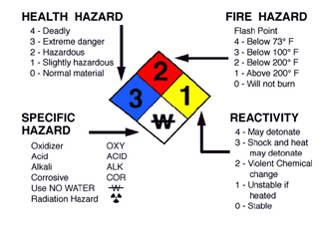
Deciding on the Best Storage Location for Multi-Hazard Chemicals
Many chemicals, especially liquid chemicals, may present several different hazards
To determine how to store multi-hazard materials be sure to
read the chemical’s SDS,
reference several published lists of incompatible chemicals for guidance,
refer to your institution’s chemical storage guidelines and
discuss with EH&S and/or your CHO
A widely published reference for determining storage group for a multi-hazard chemical is presented on the next slide

Slide 13
Ranking Multi-Hazard Liquids
Outlined below* is one example of a hierarchy of hazards, ordered from most to least hazardous, for the purposes of determining compatible storage. The correct storage group for a multi-hazard chemical is the group representing the greatest hazard (i.e., the group appearing highest in this list).
Group 1: Flammables, includes liquids with flashpoints < 100°F.
Primary Storage Concern, protect from ignition
Group 2: Volatile Poisons. Includes poisons, toxins, and select and suspected carcinogens with strong odor or an evaporation rate of > 1 (butyl acetate = 1)
Primary Storage Concern, prevent poison inhalation exposure
Group 3: Oxidizing Acids, which are highly reactive with most substances and each other.
Primary Storage Concerns, prevent contact/reaction between oxidizing acids and other substances and corrosive action on surfaces
Group 4: Organic and Mineral Acids
Primary Storage Concerns, prevent contact and reaction with bases and oxidizing acids and prevent corrosive action on surfaces
Group 5: Liquid Bases
Primary Storage Concern, prevent contact and reaction with acids
Group 6: Liquid Oxidizers, which react with everything, potential causing explosions or corrosion of surfaces.
Primary Storage Concern, isolate liquid oxidizers with other substances.
Group 7: Non-Volatile Liquid Poisons, includes highly toxic (LD₅₀ oral rat < 50 mg/kg) and toxic chemicals (LD₅₀ oral rat < 500 mg/kg), "select carcinogens", suspected carcinogens, and mutagens.
Primary Storage Concern, prevent contact and potential reaction with non-volatile liquid poisons and other substances.
Group 8: Metal Hydrides
Primary Storage Concern, prevent contact and potential reaction with liquids and in some cases air (pyrophorics).
Group 9: Dry Solids, includes all powders, hazardous and non-hazardous.
Primary Storage Concern, prevent contact and potential reaction with liquids.
* Extracted from the Fred Hutchinson Cancer Research Center’s Chemical Hygiene Plan, Chapter 9, Proper Chemical Storage,
https://extranet.fhcrc.org/EN/sections/ehs/hamm/chap3/section9/index.html

Slide 14
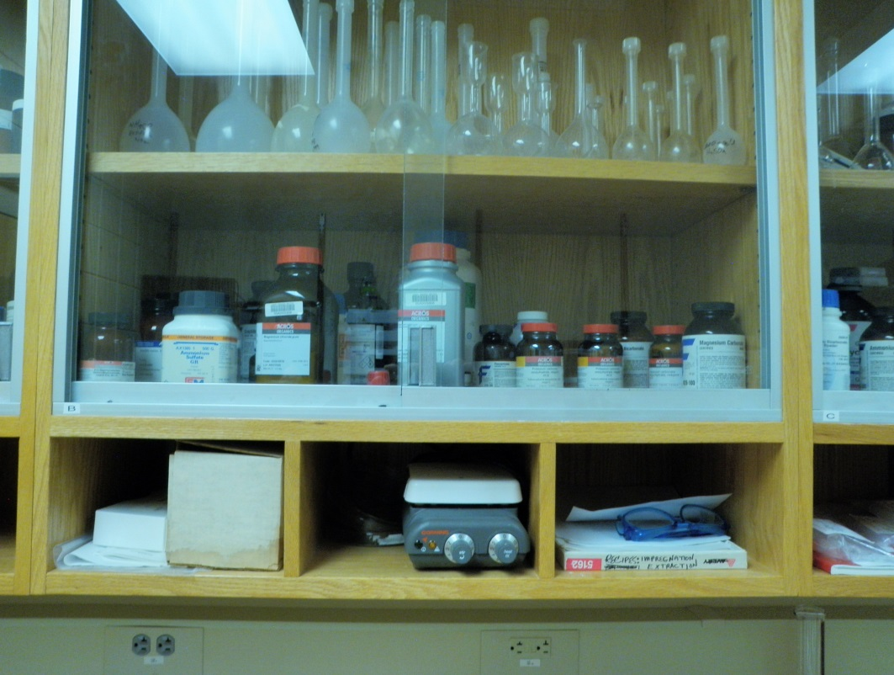
Best Management Practices for Chemical Storage
General Chemical Storage BMPs
Hazard Class Specific Storage BMPs
Corrosives
Flammables
Toxins
Oxidizers
Highly Reactives
Gas Cylinder Storage BMPs
Cryogenic Liquid Storage BMPs

Slide 15
General Chemical Storage BMPs
A designated storage place for each compound in inventory, but
Do not store chemicals on bench tops unless they are materials in actual use or of low hazard such as buffer and salt solutions
Do not store chemicals in lab hoods (exception small cylinders of toxic gases that otherwise would require a ventilated gas cabinet)
Do not store chemicals under sinks
Do not store chemicals on the floor or window ledges
Do not store chemicals near or above sinks
Do not store chemicals on top of cabinets
Never stack chemicals containers on top of each other
Storage must be maintained 24 inches or more below the ceiling in non-sprinklered areas of buildings or not less than 18 inches below sprinkler head deflectors in sprinklered areas of buildings
Return stock containers to storage location after use

Slide 16
Chemical Storage BMPs: Container Management
Chemical containers must be
constructed of material compatible with contents
in good condition (no rusting, bulging, or chemical encrustation)
properly capped
periodically inspected for signs of deterioration and label integrity
Store containers with labels facing out
Replace manufacturer's labels that have degraded
Ensure secondary containers are labeled per your institution’s guidelines. Generally the minimal acceptable information is full chemical name, hazard, date and name/initials of responsible person
If your institution’s procedures outline compatible storage groups (by letter or other means), including the Storage Group identifier on container labels is recommended
Do not store chemicals alphabetically except within a hazard family/storage group
Store liquids separately from solids
Store solids above liquids
Always store hazardous liquids in secondary containment trays manufactured from chemical resistant materials

Slide 17
Chemical Storage BMPs: Storage Areas
Storage areas should be away from direct sun and sources of ignition or heat
Ensure storage areas are well ventilated and lit
Provide adequate shelving to prevent overcrowding and accessibility issues that are wide enough so large containers do not protrude over shelf edge
Shelves should be level, secured to a permanent structure and strong enough to support weight of all the containers
To prevent risk of containers falling, shelves should be tilted slightly backward or fitted with a raised lip (2” min. recommended in seismically active areas, bungee cords or earthquake straps may be added for extra security)
Doors on chemical storage shelving units must remained closed except when removing or returning chemicals to their storage location. In seismically active locales, additional latching mechanism may be recommended or required by your institution's seismic bracing and latching policies/procedures
Chemical resistant coating on shelving is recommended
Store large and heavy containers on lower shelves no higher than 1 foot from floor
Best practice is to store hazardous chemicals below eye level. If impractical, at the very least, store corrosives and other chemicals that present eye and skin hazards on lower shelves, below eye level
In seismically active areas, chemical storage cabinets (whether floor, bench or wall-mounted) and free standing shelf units should be seismically braced per your institution's policies and procedures

Slide 18
Chemical Storage BMPs: Housekeeping-a few tips
Don’t Do this!
Reduce Clutter
Limit amount of combustibles in storage areas, especially by unpacking and removing cardboard shipping boxes
Don’t overcrowd, stack containers, or place them close to or over hanging edges of counters/shelving
Do not place materials on the floor where they could become a trip hazard
Keep drawers and cabinet doors closed when not in use
Store containers upright, compatibly with labels facing out, replace any torn or illegible labels
Keep access to emergency equipment, electrical panels and egress routes clear at all times

Slide 19
Chemical Storage BMPs: Flammable Materials Storage Cabinets
Only small quantities of flammables should ever be stored outside of flammable storage cabinets
In most jurisdictions a total quantity of > 10 gallons of flammables requires the use of approved Underwriters Laboratory (UL) or Factory Mutual (FM) listed flammable storage cabinets constructed to meet OSHA 29 CFR 1910.106 and NFPA 30 specifications
Cabinets should be equipped with self closing/self latching doors
Cabinets should be marked in conspicuous red lettering, “FLAMMABLE—KEEP FIRE AWAY”
Consider venting cabinet used to store higher hazard or odiferous chemicals
NOTE: Do not install flammable storage cabinets adjacent to room exits

Slide 20
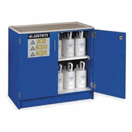
Chemical Storage BMPs: Corrosive Materials Storage Cabinets
Choose a storage cabinet’s material wisely
Many acids are corrosive to metal, so epoxy coated or non-metal units may last longer, especially when storing concentrated hydrochloric acid
Strong oxidizers, including perchloric acid, should not be stored on uncoated wood surfaces
Use of chemical resistant trays on shelves is recommended regardless of construction materials
Remember acetic and other combustible organic acids belong in their own designated corrosive cabinet or they may be stored in separate containment bins in a flammable cabinet
Corrosive Materials Storage cabinets should marked in conspicuous letters that contrast the cabinet color as either “Corrosive” or “Acid” or “Base” to indicate contents

Slide 21
Chemical Storage BMPs: Ventilated Gas Cylinder Cabinets
Local fire codes and/or your institution’s policies will call for employing ventilated gas cabinets for certain hazard classes of compressed gas, such those that are highly toxic or toxic.
When required these cabinets must maintain an average ventilation velocity at the face of gas cabinet access ports or windows of not less than 200 feet per minute (1.02 m/s) with not less than 150 feet per minute (0.76 m/s) at any point of the access port or window. In addition gas cabinets
shall be connected to an exhaust system and
shall not be used as the sole means of exhaust for any room or area
In some instances, cabinets will require an approved automated sprinkler system
Similar code requirements exist for exhausted enclosures used to compressed gas storage and use
The codes will also specify gas detection system, alarm system, emergency power, fire, heat and smoke detection and other emergency systems requirements

Slide 22
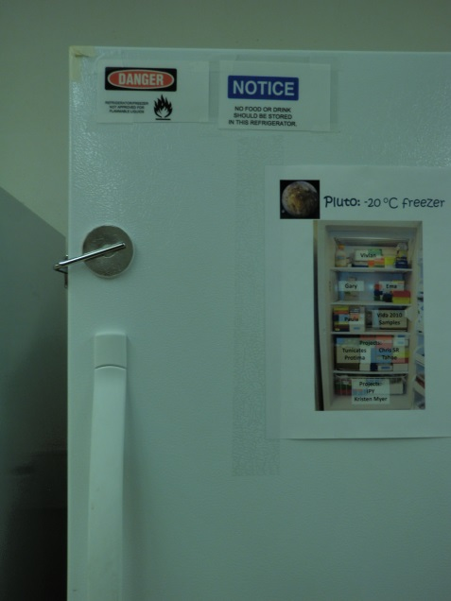
Chemical Storage BMPs: Refrigerated Storage
Store flammable material requiring refrigeration in an approved UL or FM listed flammable storage refrigerator that meets NFPA 45 and NFPA 70 guidelines
Materials requiring refrigeration should be in flammable-safe units designed for chemicals and marked solely for that use
Chemical storage refrigerators must be clearly labeled “No Food or Drink”
Consider back up power if electricity loss may create a hazardous situation
Additional latching mechanisms are recommended in seismically active locales to prevent doors from opening and dumping contents, then swinging shut again during an earthquake

Slide 23
Chemical Storage BMPs: Desiccators/Desiccator Cabinets
Desiccators are commonly employed to protect chemicals which are hygroscopic or which react with water (present in humid environments) or air
Make sure that separate desiccators are used for incompatible chemicals
Store chemicals that are air-sensitive in desiccators that can be evacuated and backfilled with an inert gas and are marked solely for that use

Slide 24
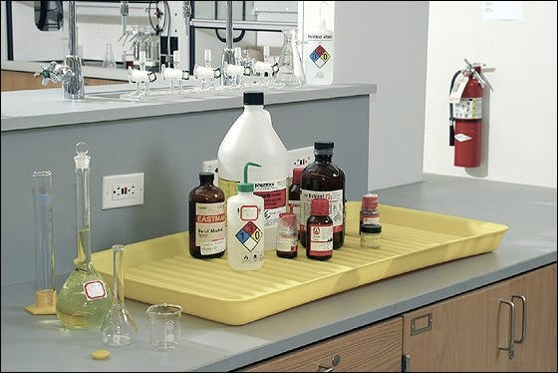
Best Management Practices for Chemical Storage, continued
Hazard Class Specific Storage BMPs for
Corrosives
Flammables
Toxins
Oxidizers
Highly Reactives
Compressed Gases
Cryogenic Liquids

Slide 25
Corrosives--Acids
Segregate
from bases
from chemicals that produce toxic gases upon contact (ex. cyanides, sulfides)
from water reactive metals (ex. sodium, potassium, magnesium)
inorganic oxidizing acids (ex. Nitric acid) from organic acids (ex. Acetic acid), flammables and combustibles
Store liquid acids in a corrosive safety cabinet whenever possible. Use plastic tubs or trays for secondary containment, especially with metal shelving, even if coated with corrosive resistant paint
Oxidizing acids should be stored in double containment
Store acids on lower shelves, below eye level
Concrete surfaces in acid storage rooms should be painted/sealed to prevent reaction between acids and cement

Slide 26
Corrosives-Bases
Segregate from acids, metals, organic peroxides and easily ignitable materials
Store in dry locations
Store bases in a corrosive safety cabinet whenever possible. Use plastic tubs or trays for secondary containment, especially with metal shelving, even if coated with corrosive resistant paint
Store concentrated bases on lower shelves, below eye level
Store solutions of inorganic hydroxides in polyethylene containers

Slide 27
Flammables
Store separately from other hazard classes (especially oxidizing acids and oxidizers)
Store away from all ignition sources, open flames, sparks, hot surfaces, direct sunlight
Store in UL or FM listed cans or cabinets that meet OSHA and NFPA spec. Cabinet doors should be self-closing, self-latching.
Provide bonding and grounding for dispensing flammable liquids where static electricity is likely to be present
Do not use or store flammables in cold rooms/environmental chambers where air is recirculated
Use only explosion-proof or intrinsically-safe refrigerators and freezers that are UL or FM listed and meet NFPA 45 and NFPA 70 specs for flammable liquids requiring cold storage

Slide 28
Toxins
Ensure containers are tightly sealed
Keep quantities on hand at a minimum
Separate from other hazard classes and store in a cool, well-ventilated area away from light and heat
Liquid toxins should be stored below eye level
Do not store on open shelves
Volatile toxins may require ventilated storage cabinet for larger quantities

Slide 29
Toxins, continued
Use highly toxic chemicals only in a designated use area
Highly toxic chemicals that produce vapor or dust should always be handled within a chemical hood or ventilated powders weighing hood
Toxic gases may require ventilated gas cabinets, depending on LC₅₀
Cyanides should be stored away from acids and oxidizers in a secure cabinet that can only be accessed by authorized personnel
Use level of security required by your institution for toxics and highly toxics in inventory

Slide 30
Oxidizers
Keep separate from flammables, combustibles, and reducing agents such as zinc, alkaline metals and formic acid
Segregate inorganic oxidizers from organic peroxides
Store oxidizers in a cool dry area in cabinets made of noncombustible material
NOTE: Storage of liquid oxidizers on unpainted wooden surfaces is prohibited
Store organic peroxides in an areas, such as a refrigerator, where the temperature will remain below the self accelerating decomposition temperature

Slide 31
Highly Reactive Chemicals: Pyrophoric Substances and Water Reactive Chemicals
Pyrophoric Substances
Store in a dark, cool, dry place away from other flammables
Prevent contact with air. Ensure provisions are in place for maintaining an air tight seal on containers
Take precautions to prevent containers from leaking or breaking. Use corrosion and shatter resistant secondary containers for transportation and storage
Keep in mind that many pyrophoric chemicals are also water reactives
Water Reactive Chemicals
Store in a cabinet in a cool, dry place away from other flammables
Keep away from water. Do not store under sinks, near water bathes or under sprinkler heads
Store in a desiccator or desiccator cabinet as necessary to maintain low humidity atmosphere
Ensure a class D fire extinguisher is available in work area where water reactives are used or stored

Slide 32
Highly Reactive Chemicals: Explosives
Explosives--includes chemicals that may become explosive through contamination (e.g., perchloric acid contaminated with organic compounds or metals) and chemicals that may degrade over time and become explosive (ex. dry picric acid or certain peroxide forming alcohols and ethers)
Identify all explosive and potentially explosive chemicals in inventory. For chemicals that may degrade and become potentially explosive, record opening and discard dates on the container
Keep explosive chemicals separately and away from all ignition sources: open flames, hot surfaces, direct sunlight, sparks
Consider designating a special area to store and use explosive chemicals
Ensure everyone who uses explosive or potentially explosive chemicals is thoroughly trained in safe storage methods, conditions to avoid and the hazards of the material and disposal procedures
Some explosives may require storage in and explosive magazine accessible to authorized personnel only

Slide 33
Highly Reactive Chemicals: Peroxide Formers
Ensure peroxide forming compounds are labeled with receiving, opening and disposal dates and periodically check containers for formation of peroxides. (Note: Test all peroxide formers prior to distillation regardless of age.)
Store peroxide formers in airtight containers in a cool dark place with other compatible chemicals
For storage of larger numbers of peroxide forming chemicals, consider designating a special area to store them to make managing inventory easier
Never store in freezers as sublimation may cause detonation
Ensure everyone who uses chemicals is thoroughly trained in safe storage methods, conditions to avoid and the hazards of the material and disposal procedures.
Many common peroxide formers used in laboratories become more dangerous due to concentration upon distillation
Check inventory frequently to ensure expiration dates have not passed and to look for evidence of contamination, degradation or any noticeable change in physical or chemical characteristics
If precipitate or an oily layer is present do not move container.

Slide 34
Compressed Gas Storage
Store cylinders upright
Storage areas must be well drained, well ventilated and kept conditioned so temperature does not exceed 125⁰ F (51.7⁰ C). With large, self-venting tanks, consider the room size, to prevent asphyxiation during venting of gases
Keep cylinders away from heat and open flames, in a dry location. Do not place them where they can become part of an electrical circuit or where objects can fall on or against them
Never store cylinders in walk-in freezers, cold rooms or environmental chambers where lack of ventilation poses a potential hazard during a release. Storage in subsurface locations or enclosed spaces, such as basements, should be avoided
Segregate gases by compatible classes as is required for incompatible chemicals For storage locations this is typically 20” apart or via a 5 foot-30 minute fire wall between incompatibles. Additionally it is best practice to provided adequate space for compatible segregation so full cylinders are separate from empty cylinders
Do not store oxygen or other oxidizing gas near combustible materials

Slide 35
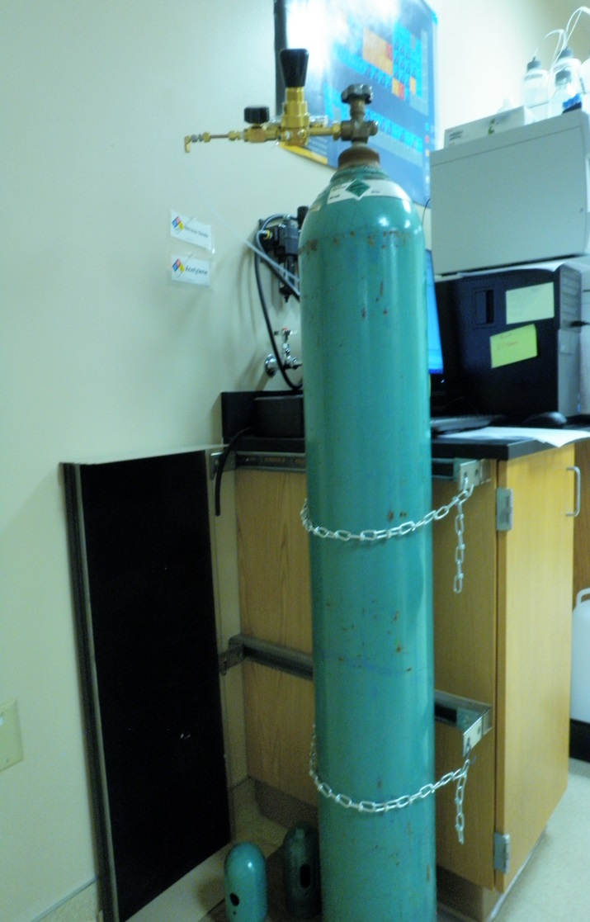
Compressed Gas Storage, cont’d.
Secure cylinders so they will not fall in quake
Double chaining recommended, ~1/3 cylinder length from top and the other ~ 1/3 from the bottom.
Bench clamps may fail in quake if they aren’t bolted to the counter.
Straps can melt in a fire, so chaining is recommended, but not gang chaining
Cylinder racks are strongly recommended as long as chains can be configured so cylinders are secured tightly
Toxic gases, highly toxic gases and pyrophoric gases require additional ventilation and controls, thus should be stored and used in accordance with your institution’s policies and procedures

Slide 36
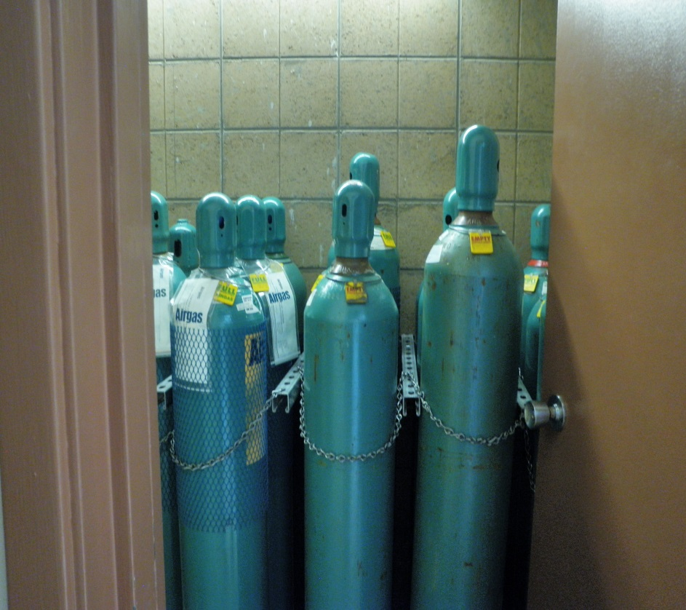
Compressed Gas Storage, cont’d.
Keep valve caps on in storage and remove regulators and replace valve caps on cylinders that are not connected to equipment or used on a regular basis
Cylinder labels should face out or signs should be placed immediately adjacent to cylinders to indicate the contents
Use cylinder tags to indicate status of cylinder-”full”, “in-use”, “empty”
If you suspect a cylinder is leaking, use a soap solution to determine site of leak. Remove cylinder from service if leak cannot be easily corrected

Slide 37
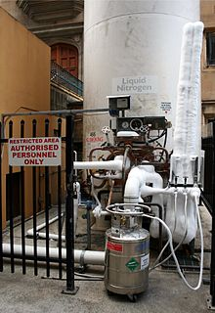
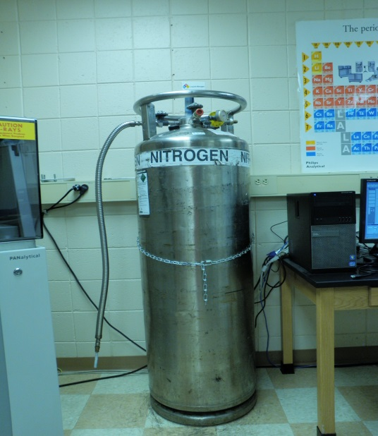
Cryogen storage
Store and handle in a well-ventilated area. Do not use or dispense in small enclosed spaces as potential for oxygen deficiency exists when liquid cryogens convert to the gaseous phase
Use approved storage vessels with pressure relief valves
Both liquid nitrogen and helium can liquefy oxygen from air, creating an oxygen rich situation and strong fire or explosion hazard
In seismically active locations, ensure wheeled Dewars are locked down or chained in place to prevent movement
Ensure additional PPE, such as full face shield and cryogen gloves, are available in storage areas where dispensing will occur

Slide 38
Additional Considerations for Chemical Storage
Labeling/Marking Chemical Storage Areas
Safe Tips for Transporting Chemical Containers to and from Storage Areas
Emergency Equipment
Inspections
Security

Slide 39
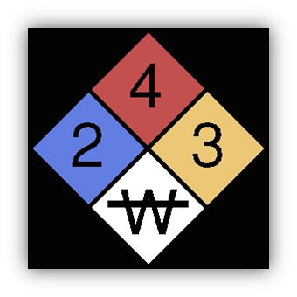
Chemical Storage BMPs: Marking Chemical Storage Areas
Unless otherwise exempted fire code officials will require visible hazard identification signs as specified in NFPA 704
for the specific material contained in stationary containers and aboveground tanks and
at entrances to locations where hazardous materials are stored, dispensed, used or handled in quantities requiring a permit and
at specific entrances and locations designated by the fire code official.
NFPA 704 Fire Diamond
Red-Flammability
Blue-Health
Yellow- Instability/Reactivity
White-Special Hazard Symbols such as water reactive shown in example
Numbers ranges from 0 (practically nonhazardous) to 4 (most extreme hazard)*
Follow the hazardous materials use and storage marking procedures and format required by your institution’s policies
*NOTE: The NFPA numbering system is opposite that of GHS/Hazard communication where 1 is extremely hazardous and 4 is practically innocuous

Slide 40
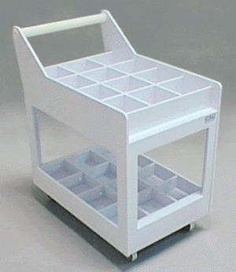
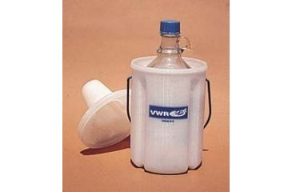
Chemical Storage BMPs: Safety Tips for Transporting Chemicals in a Building
Avoid high traffic areas whenever possible
Use carts with lips to move chemicals. If transporting several hazard classes at the same time, segregate by hazard class in bins or tubs. Protect against breakage with non-reactive cushioning materials as necessary.
To hand carry chemicals use a sturdy lipped tray for plastic containers and bottle carriers for glass containers. Do not hand carry heavy containers and never attempt to move more than a couple of containers by hand.
Do not hand carry bottles up or down stairs, use the (preferably freight) elevator instead
When transporting chemicals, wear the same PPE required for use. Be careful not to transfer chemical contamination by touching door handles and the like with gloved hands.
Never carry an evacuated desiccator

Slide 41
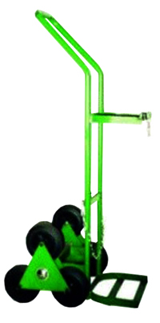
Chemical Storage BMPs: Safety Tips for Transporting Chemicals, cont’d.
Gas Cylinder Transport Tips
Use cylinder carts equipped with chains or other devices to secure cylinders
Never transport a single cylinder on a cart designed for dual cylinder transport
Valve protection caps should be in place when cylinders are transported, moved, or not connected for use. NEVER move a cylinder with a regulator attached
Avoid dragging, rolling or sliding cylinders or attempting to move one any distance by hand

Slide 42
Chemical Storage BMPs: Safety Tips for Transporting Chemicals, cont’d.
Cryogenic Liquid Transport Tips
Wear all required PPE and use no fewer than two personnel to transport cryogenic liquids and use handcarts equipped with brakes for large Dewars and cylinders
Never transport an open container of cryogenic liquid, no matter how small
Plan the route of transport avoiding elevators if at all possible because in event of an elevator failure or spill, the space may quickly undergo oxygen displacement. If the use of an elevator is unavoidable, send your buddy to the receiving floor. Then load the Dewar onto the elevator. Remain on the sending floor while you send the Dewar to the receiving floor unmanned. After the Dewar is unloaded, join him/her for the rest of the transport. If the transport by elevator takes place over multiple floors, clearly label the Dewar with a warning to anyone who may want to use the elevator between the sending and receiving floors to wait until the transport process is complete.
Always use care when handling equipment. Damage to Dewars could result in the loss of vacuum and increased evaporation. Transport of helium Dewars requires extra care because they are fragile.

Slide 43
Chemical Storage BMPs: Safety Tips for Transporting Chemicals, cont’d.
Cryogenic Liquid Transport Tips, cont’d.
When at all possible, do not hand carry cryogenic liquids. For larger Dewars use a stable wheeled base designed for the Dewar transport. Check to ensure stability before commencing transport.
When carrying a Dewar, make sure it is the only item you are carrying. Hold the Dewar as far away from the face as possible. Be on the lookout for other people who may run into you or bump you.
Large mobile Dewars used for transport should be equipped with a braking mechanism. Do not use feet to brake. Steel toed boots are recommended.
Take care to avoid crushing hands or fingers between the vessel or cart and walls or door frames.
If there is any risk of tipping, a cart should be used. Wheeled trolleys may not be used if the vessel must pass over elevator thresholds or other slots/crevasses wider than 25% of the wheel width.

Slide 44
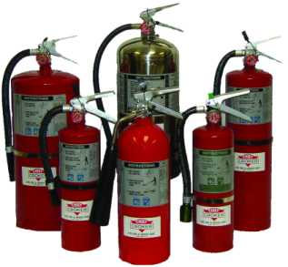
Chemical Storage BMPs: Emergency Equipment
Ensure the following emergency equipment is available in chemical use and storage areas
appropriate fire extinguishers,
safety shower and eyewash,
appropriate first aid supplies
appropriate spill kits/spill clean up supplies and
appropriate PPE for the chemicals present
And that all chemical users know your institution’s emergency procedures, including
how to sound the alarm/notify co-workers of the emergency
when and where to evacuate
where emergency equipment is located and how and when to use it
how to maintain the emergency equipment
whom to notify when equipment requires repairs or replacement

Slide 45
Chemical Storage BMPs: Inspections
Chemical storage areas should be inspected at the frequency specified by your institution or if none exists, at least annually
Inspections should include
verifying good housekeeping is maintained, especially egress routes and paths to emergency equipment are kept free from obstruction
verifying chemicals are stored compatibly
examining stored chemicals for
signs of deterioration (crystal formation, color change, etc.),
container leakage/container integrity
ensuring chemical containers are closed and caps are in good condition
ensuring chemical containers are labeled with legible labels that face outwards

Slide 46
Chemical Storage BMPs: Inspections, continued
Inspections, continued
examining storage cabinets and shelves for signs of overloading, degradation, etc.
verifying doors on shelving units are closed except when adding or removing chemicals and that self-closing/self-latching doors, if present, are operating correctly
verifying that secondary containment trays are in good condition
identifying off-spec or unneeded chemicals for disposal
and any thing else required by your institution's chemical storage policies and procedures
Ensure required corrective actions related to maintaining safe chemical storage are completed in a timely manner

Slide 47
Chemical Storage BMPs: Security
Follow institutional policies for securing labs and other areas where chemicals are used and stored. At a minimum these areas should be restricted to authorized users only and locked when unattended.
In addition, certain types of chemicals, such as DEA controlled drugs; drug precursor compounds; 100 proof alcohol; explosives; particularly hazardous substances (e.g., high acute toxins, carcinogens and reproductive toxins); and chemicals on the Department of Homeland Security’s chemicals of interest list may require more stringent security measures, including locked cabinets, access restricted to designated personnel, check-out/check-in logs, etc..

Slide 48
Summary
Chemical management is one of the most important aspects of an institution’s safety program. This presentation covered many of the best management practices (BMPs) that should be followed for chemical management (with the emphasis on safe hazardous chemical storage practices). By adopting BMPs for chemical management, educating employees/students on these practices and verifying adherence to them through ongoing inspections/audits you will go a long way toward preventing workplace chemical incidents from occurring.

Slide 49
Select References
Chemical Safety Manual for Small Businesses, third edition; American Chemical Society; 2007
Handbook of Compressed Gases, fourth edition; Compressed Gas Association, Inc.; Kluwer Academic Publishers, 1999 (note a fifth edition was published April 2013)
2015 International Fire Code; International Code Council, Inc.; 2014
NFPA 45, Standard on Fire Protection for laboratories Using Chemicals, 2015 edition; National Fire Protection Association
Occupational Exposure to Hazardous Chemicals in Laboratories; OSHA, Title 29 Code of Federal Regulations1910.1450
Proper Chemical Storage, Chapter 9, Fred Hutchinson Cancer Research Center’s Chemical Hygiene Plan
Prudent Practices in the Laboratory: Handling and Management of Chemical Hazards, updated edition; National Research Council (US) Committee on Prudent Practices in the Laboratory. Washington (DC): National Academies Press (US); 2011.
Safe Handling of Compressed Gases in the Laboratory and the Plant; Matheson Gas
Safe Storage of Hazardous Chemicals Booklet; Office of Environmental Health and Safety, University of California Berkeley
Safety in Academic Chemistry Laboratories, volume 2; Accident Prevention for Faculty and Administrators,
7th edition; American Chemical Society; 2003

