Slide 1


Analysis of the
Economic Impact and
Return on Investment of Education
The economic value of Suffolk County Community College
FY 2016-17

Slide 2
Emsi & Community Colleges
ADVISORS IN LABOR MARKET INFORMATION
15+
1/2+
Years working with community colleges
Of U.S. community colleges have used Emsi’s economic impact studies
1.2M
6 of 10
Students used Emsi’s career
pathways tools last year
2017 Aspen Prize finalists are Emsi customers
Notes:
We have completed over 1,700 EIS across US, UK, and Canada (with over 83% done for US clients)

Slide 3

What is an
Measures how an event or institution affects the local economy.
What is an
A comparison of the costs and benefits to determine the return on investment.

Slide 4

About Suffolk County
Average earnings by education level
at career midpoint
$60,600
$39,300
$34,100
$99.9 billion
$29,800
Total gross
regional product (GRP)
$22,400
890,248
< HS
HS
Certificate
Associate
Bachelor's
Total jobs

Slide 5
SCCC in FY 2016-17
32,332
3,288
credit students served
Non-credit students served
2,649
$187.7 million
Employees
Total Payroll/Benefits
7%
$82.3 million
students from outside
the region
Total tuition revenue

Slide 6
OVERVIEW OF RESULTS
$1.1 billion
14,372
total income Added
in the region
Total Jobs supported in the region
20.6%
26.7%
Rate of return to students
Rate of return to taxpayers
1.1%
of region’s GRP

Slide 7
Operations
Spending Impact
Construction
Spending Impact
College payroll and other spending + ripple effects
College construction expenditures + ripple effects
$258.7 million
$13.7 million
added regional
income
added regional
income
or
or
3,565
128
Jobs supported
in the region
Jobs supported
in the region
All results measured in income, not sales.
Results are net of counterfactual scenarios.

Slide 8
Student
Spending Impact
Alumni
Impact
Relocated/Retained student spending + ripple effects
Higher alumni earnings
and increased business profit
+ ripple effects
$38.4 million
$820.5 million
added regional
income
added regional
income
or
or
587
10,092
Jobs supported
in the region
Jobs supported
in the region
All results measured in income, not sales.
Results are net of counterfactual scenarios.

Slide 9
Total Impact
$1.1 billion
Impacts by industry
Total INCOME added
IN THE REGION
or
16,000
1.1%
14,000
1,534
Health Care & Social Assistance
OF REGION’S GRP
12,000
1,494
1,162
Professional & Technical
JOBS
10,000
Services
14,372
8,000
Total JOBS SUPPORTED IN THE REGION
6,000
Other Services (except Public
Administration)
10,181
or
4,000
1 out of every 62
All Other
2,000
Jobs THE REGION
0

Slide 10
Student
Perspective
Taxpayer
Perspective
Social
Perspective
$1.5 billion
$14.5 billion
Benefit: Higher future
earnings
Benefit: Future tax revenue,
government savings
Benefit: Future earnings, tax revenue, private savings
Cost: Tuition, supplies, opportunity cost
Cost: State and
local funding
Cost: Student and
all college costs
11.1
28.1
Benefit/Cost ratio
Benefit/Cost ratio
Benefit/Cost ratio
20.6%
N/A
Rate of return
Rate of return
Rate of return
Future benefits are discounted to the present.

Slide 11
Next Steps
Send the executive summary to local legislators.
Use social media to broadcast student returns to prospective students and parents.
Share industry impacts with local business partners.
Leverage impacts for proposals, grant writing, & strategic planning.
Use campus fliers, newsletters, & websites to publish results.
Share results with local media.
How can
Emsi help?
Emsi’s Press Packet
Ongoing presentations from your Emsi economist
Email/call us anytime

Slide 12
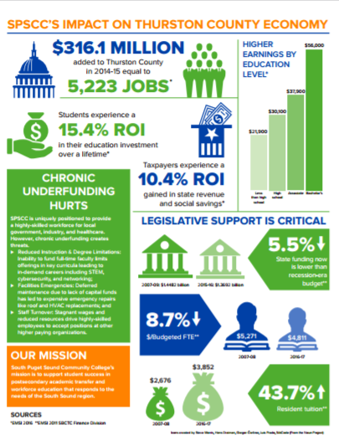

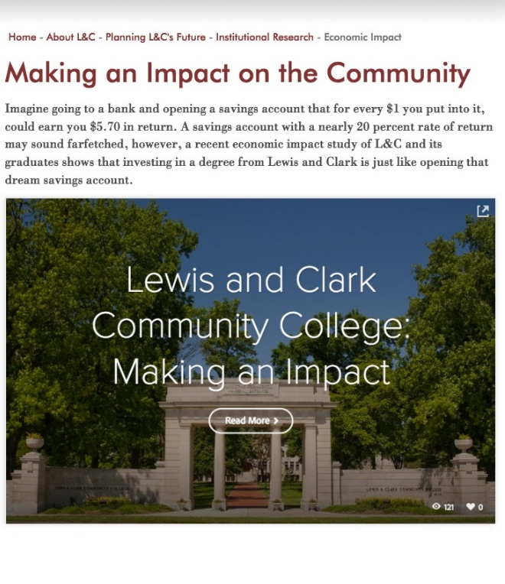

Share Your Results
Combine your results with other institutional highlights to create a fact sheet.
Include your results in your periodic publications.
Create a web page that includes written highlights, animations, and videos.

Slide 13
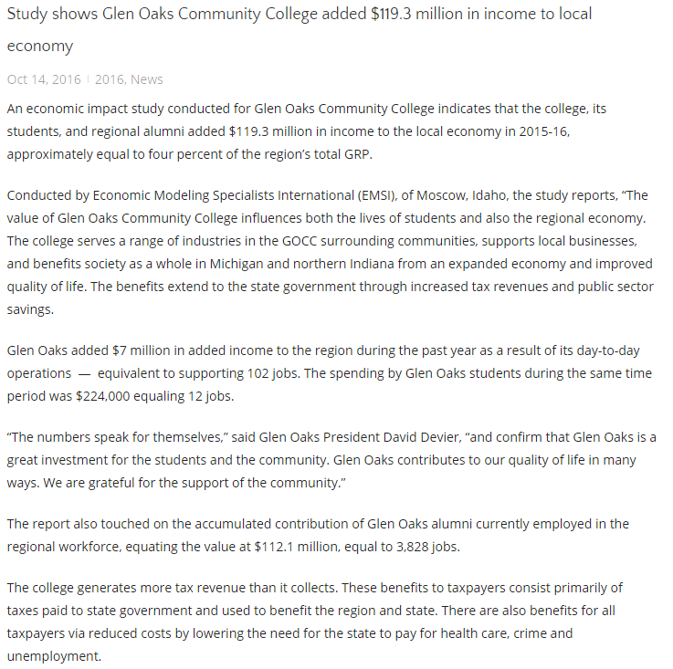
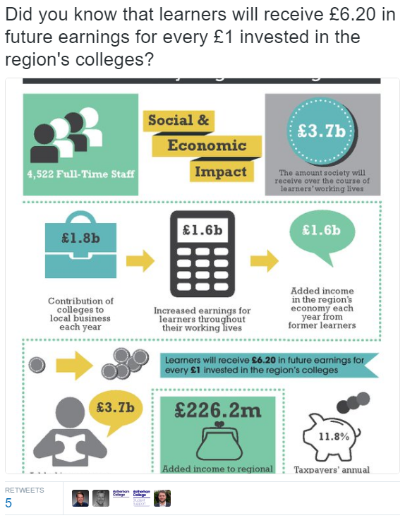
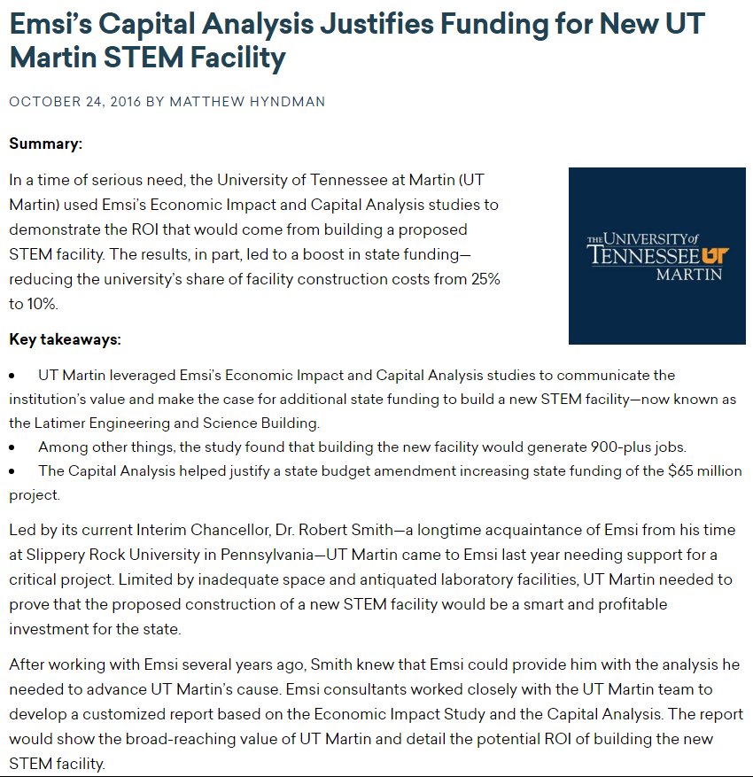
Share Your Results
Create a press release and share with your state and local media.
Use social media to share your investment results with prospective students.
Use your study to help secure additional funding.

Slide 14

The results of this study were prepared by
For a copy of the report, please contact the College.

