Slide 1
Sustainability at Suffolk County Community College
N. Palumbo
Dec. 4, 2014

Slide 2
What is Sustainability?

Slide 3
Sustainability
“We cannot solve our problems with the same thinking we used when we created them.” Albert Einstein
Sustainability: Meeting the needs of the present without compromising the ability of future generations to meet their own needs.

Slide 4
The 7 Dimensions of Sustainability University Leaders for a Sustainable Future
Institutional Mission, Structure & Planning
Faculty & Staff Development
Student Opportunities
Curriculum
Operations
Community Outreach & Service
Research & Scholarship

Slide 5
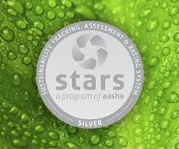
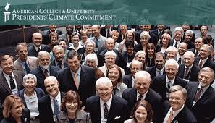
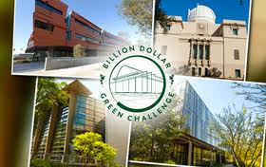
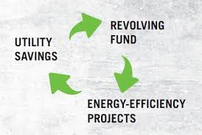
Institutional Mission, Structure & Planning
Formal written statements of mission and purpose reflect a commitment to sustainability.
Positions, committees, etc. exist which reinforce sustainability.
Sustainability and environmental issues given broad visibility on campus.
BOT Resolution No. 2014.75 – Adopting and Energy Conservation Policy

Slide 6
Faculty & Staff Development
Hiring, tenure and promotion recognize faculty contributions to sustainability.
Faculty and staff development opportunities enhance environmental awareness and sustainability.

Slide 7
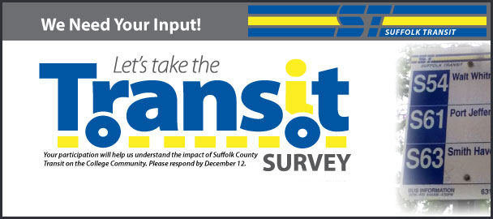
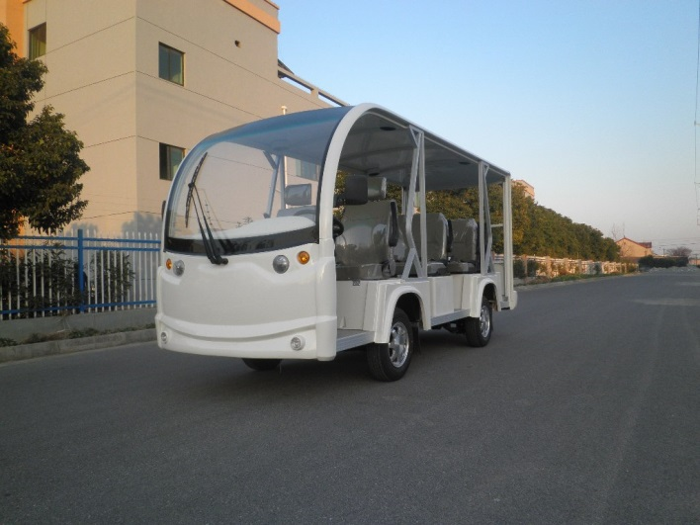
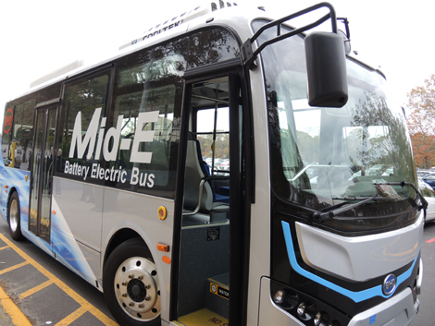
Student Opportunities
Orientation and opportunities for student action and involvement in sustainability initiatives
Exposure to environmental and sustainability-related careers
Internships
New Degree Programs in Development
Creation of Clubs/Orgs.

Slide 8
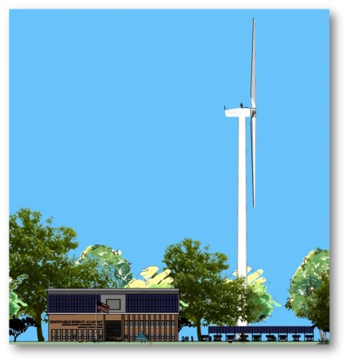
Curriculum
Courses with sustainability content in all departments
Sustainability part of traditional disciplinary education
Institution's relationship to surrounding environment part of formal and informal education.
Evaluating Certificate Options
Considering Sustainability Based Freshman Seminar

Slide 9
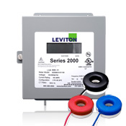
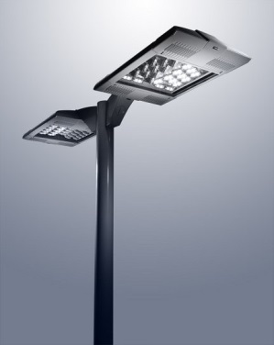
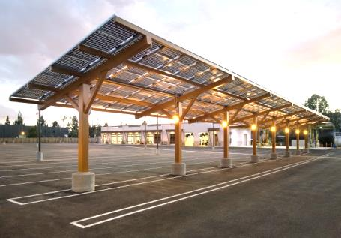
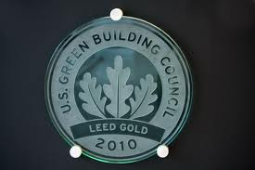
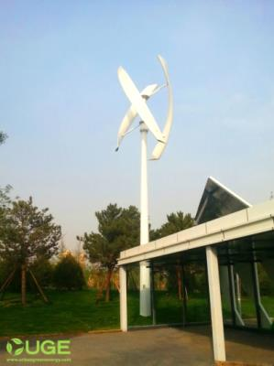
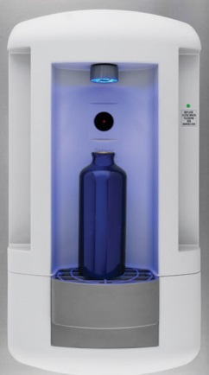
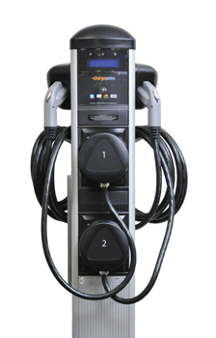
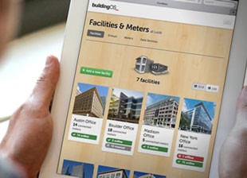
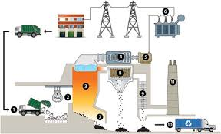
Operations
Environmental and sustainability practices (such as energy conservation and waste reduction).
Operations integrated into education and research.
Cenergistic Project: $13.5M – Net 10 Year Savings
Example Opportunity: Shinnecock Building (Eastern Campus)
36,000 sq. ft.
$100K LED Lighting retrofit = 4 year ROI
Renewable Energy costs now comparable to fossil fuels

Slide 10
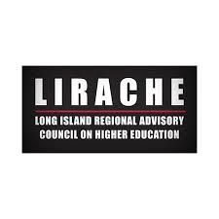
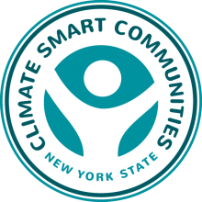
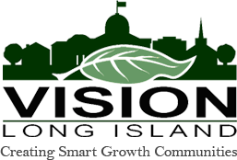
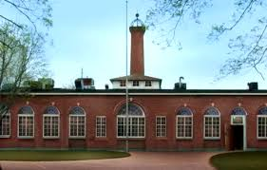
Community Service & Outreach
Projects and programs support sustainable communities
Partnerships for sustainability with K-12, business, government and other institutions at regional, national and international levels
Renewable Energy & STEM Center featured as showcase project in regional Climate Smart Communities Report sent to NYSERDA.

Slide 11
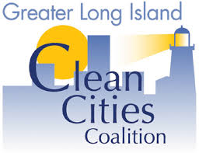
Research & Scholarship
Research and scholarship on sustainability-related topics/issues.
Interdisciplinary programs/structures for research and policy development.

