Slide 1
Wheel of Learning
6
1
Click on the Wheel to spin
Click on the Wheel to stop it
Click on the number to go to the question
5
2
4
3

Slide 2
Question 1
Answer the Question
Click on the Question to see the answer
How much did the College save on energy from 2015-2021?

Slide 3
Answer 1
Click on the Answer box to see the puzzle piece
Over $7.9M

Slide 4
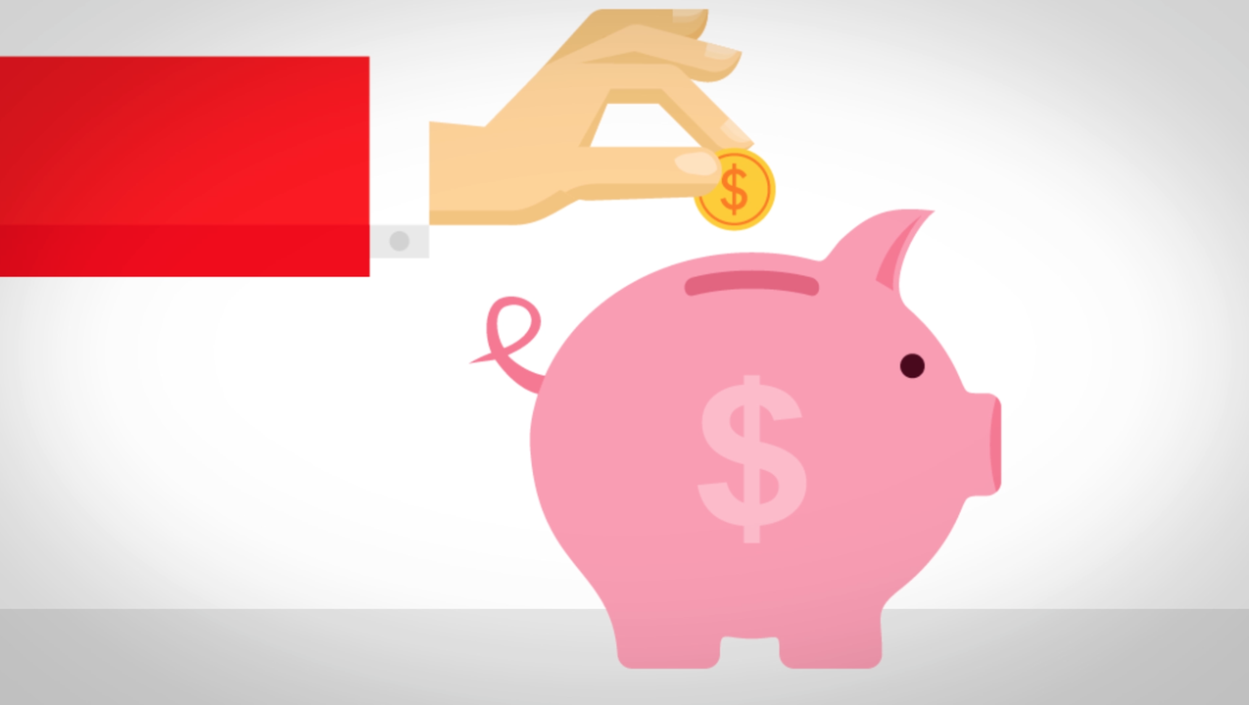
Guess what the puzzle piece means in words
Click on the puzzle piece to see the answer

Slide 5
Puzzle Answer 1
Click on the Answer
Save

Slide 6
Wheel of Learning
6
1
Click on the Wheel to spin
Click on the Wheel to stop it
Click on the number to go to the question
5
2
4
3

Slide 7
Question 2
Answer the Question
Click on the Question
Name types of clean energy?

Slide 8
Answer 2
Wind, Solar, Hydro, Geothermal, and Nuclear
Click on the Answer box

Slide 9
Guess what the puzzle piece means in words
Click on the puzzle piece to see the answer

Slide 10
Puzzle Answer 2
Click on the Answer
Energy

Slide 11
Wheel of Learning
6
1
Click on the Wheel to spin
Click on the Wheel to stop it
Click on the number to go to the question
5
2
4
3

Slide 12
Question 3
Answer the Question
Click on the Question to see the answer
Do solar panels generate electricity in the Winter?

Slide 13
Answer 3
Yes, but not as much as in the Summer.
Click on the Answer box to see the puzzle piece

Slide 14
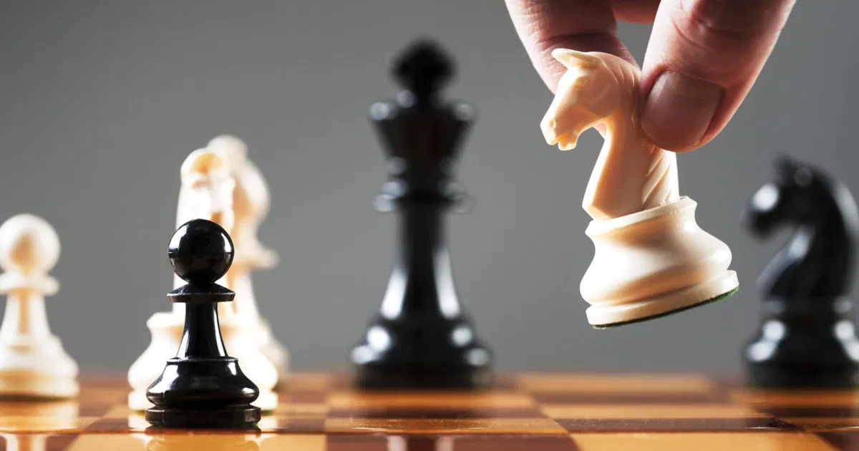
Guess what the puzzle piece means in words
+
?
Click on the puzzle piece to see the answer

Slide 15
Puzzle Answer 3
Click on the Answer
Purchase

Slide 16
Wheel of Learning
6
1
Click on the Wheel to spin
Click on the Wheel to stop it
Click on the number to go to the question
5
2
4
3

Slide 17
Question 4
Answer the Question
Click on the Question to see the answer
What is
Wish-Cycling and why is it not good?

Slide 18
Answer 4
Click on the Answer box to see the puzzle piece
Adding something to the recycling bin hoping it can be recycled. It can contaminate the load.

Slide 19
Guess what the puzzle piece means in words
Click on the puzzle piece to see the answer

Slide 20
Puzzle Answer 4
Click on the Answer
Energy

Slide 21
Wheel of Learning
6
1
Click on the Wheel to spin
Click on the Wheel to stop it
Click on the number to go to the question
5
2
4
3

Slide 22
Question 5
Answer the Question
Click on the Question to see the answer
What is Phantom (Vampire) Load?

Slide 23
Answer 5
Click on the Answer box to see the puzzle piece
Plugged-in devices that draw energy when they are plugged in but not in use.

Slide 24
Guess what the puzzle piece means in words
Click on the puzzle piece to see the answer

Slide 25
Puzzle Answer 5
Click on the Answer
Star

Slide 26
Wheel of Learning
6
1
Click on the Wheel to spin
Click on the Wheel to stop it
Click on the number to go to the question
5
2
4
3

Slide 27
Question 6
Answer the Question
Click on the Question to see the answer
How can you reduce phantom load?

Slide 28
Answer 6
Click on the Answer box to see the puzzle piece
Turn off items such as personal computers, monitors, printers when not in use.

Slide 29
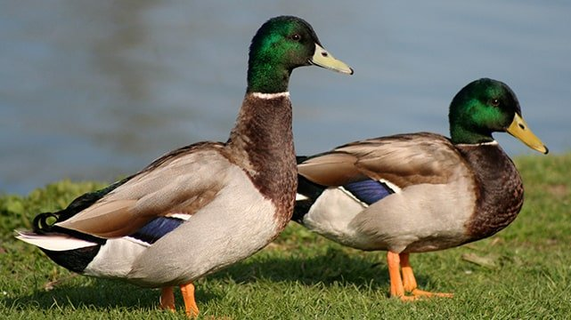
Guess what the puzzle piece means in words
Click on the puzzle piece to see the answer
+

Slide 30
Puzzle Answer 6
Click on the Answer
Products

Slide 31
Congratulations – You Solved the Puzzle!
Save
Energy
Purchase
Energy
Star
Products

