Slide 1

Helpful Tips in Creating a Strong Resume
Purpose of a Resume
To market the skills, qualifications and experiences related to the job you are seeking in order to secure an interview.
Notes:
*To describe our work experience to the best advantage for the respective employer
*A good resume will highlight your skills, qualifications and experiences related to the job your seeking.

Slide 2
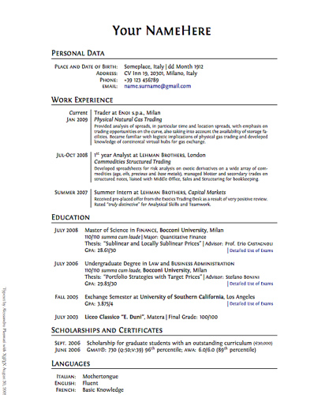
Resume Styles
Sample Resume
Select a style to best fit your needs:
Reverse Chronological: most recent experience first
Functional or Skills-Based Resume focuses on your skills and experience, rather than on your chronological work history. It is typically used by job seekers who are changing careers, who have gaps in their employment history, or whose work history is not directly related to the job
Combination or hybrid : Is a mix between the reverse-chronological and functional resume formats.
You can highlight the skills you have that are relevant to the job you are applying for, as well as provide chronological work history.
Notes:
Reverse Chronological: List your work experience in reverse Chronological order, this is most often used.
Functional: This type is not often used. The focus is on accomplishments and abilities rather than work history. This type is used if you are a recent college grad with no work experience or if you have been out of work for a long time.
Combination: Combines the skill & achievements from the functional resume and the employment history from the Chronological resume.

Slide 3
Where to Begin?
Organize your information
Evaluate your strengths, qualifications and skills
Do your research!
Look at various resume styles & samples for ideas
Determine your focus/job goal
Notes:
**Organize! Heading, Name, Phone Number**
Evaluate!
*Research! Google sample resumes to find a style that works for you
*Focus/Goal! What do you want from this job? Is it what you are looking for?
*Remember to check that your voicemail message and email address is professional.

Slide 4
General Guidelines
Helpful Tips:
Utilize "key words” using Applicant Tracking System (ATS)
1-2 pages long (one is best)
Prioritize content
Keep margins between .5 to 1 inch
Use a professional, readable font such as Times New Roman or Garamond (10-12 size font)
Use action verbs, no “I” statements
Highlight your remote working skills, if applicable
Resume are read quickly, under 30 seconds
Things to Avoid:
Personal information such as age, weight, birth date and social security number
Typos and grammatical errors
Generic resume used for everything
Lying or exaggerated information
Using profanity, slang, or abbreviated terms

Slide 5
Helpful Action Verbs for Your Resume
Academic, Education & Research
Achieve, Analyze, Assist, Contribute,
Demonstrate, Develop, Document, Examine,
Inform, Instruct, Perform, Produce,
Research, Review, Study, Teach
Management and Leadership
Accomplish, Administer, Conduct, Coordinate,
Create, Direct, Enhance, Implement,
Increase, Launch, Lead, Monitor,
Motivate, Organize, Recommend, Train
Entrepreneurial and Innovative
Anticipate, Assemble, Attain, Conceptualize,
Construct, Establish, Generate, Initiate,
Interpret, Invent, Prepare, Present, Produce, Revamp, Revitalize, Sell
Technical
Accelerate, Audit, Calculate, Compile, Compute, Design, Estimate, Evaluate, Examine, Formulate, Interface, Program, Redesign, Simplify, Solve, Survey, Translate,
General or Broad
Assume, Broaden, Challenge, Clarify, Collaborate, Contribute, Facilitate, Implement, Maintain, Operate, Encourage, Explain, Prepare, Support

Slide 6
Career Services CONTACT INFORMATION
Ammerman Campus
careerservices-ammr@sunysuffolk.edu
631-451-4049
East Campus
careerservices-east@sunysuffolk.edu
631-548-2572
Grant Campus
careerservices-west@sunysuffolk.edu
631-851-6537

